Slide 1
Wholesale Customer
In Lisbon, Portugal

Slide 2
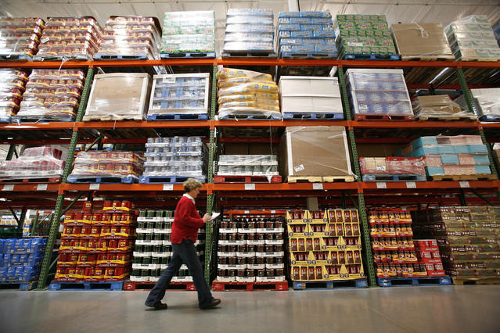
Stakeholder
wholesale distributor's owner
He would like to know, according to their shopping habits, how could all his customers be categorized into different types
So that it enables him to target at different groups of customers using specific approach to maximum the profit.

Slide 3
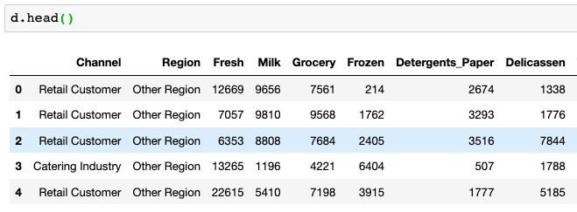


Information in the dataset
From UCI.edu
Total 440 rows / customers
2 Channels: Catering and Retail
3 Regions: Lisbon, Oporto and other regions
Numbers are: annual spending in monetary units

Slide 4
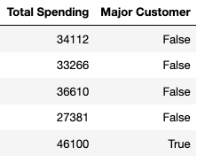

Additional information retrieved from the dataset
>= 40000, "Major Customer"] = True
< 40000, "Major Customer"] = False

Slide 5
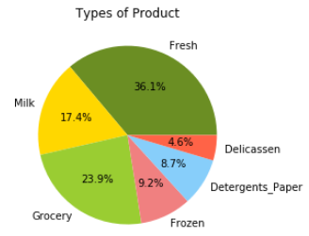
Income from Products
36.1% from Fresh Product
23.9% from Grocery Product

Slide 6
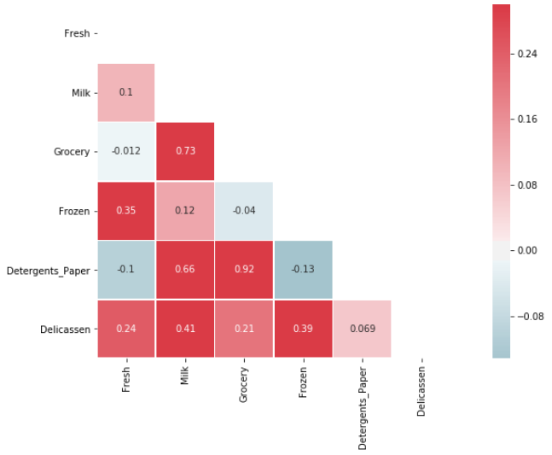
Inter - Product
0.92 –
Detergents_Paper ~ Grocery
0.73 –
Grocery ~ Milk
0.66 –
Detergents_Paper ~ Milk

Slide 7
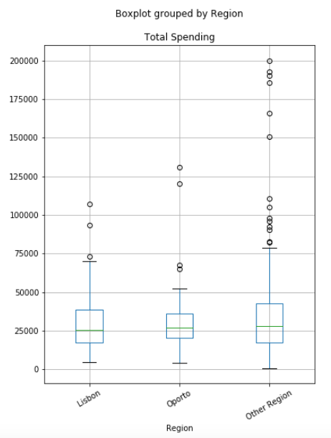
Regions
Not evenly distributed
More customer from other regions
Average is about the same

Slide 8
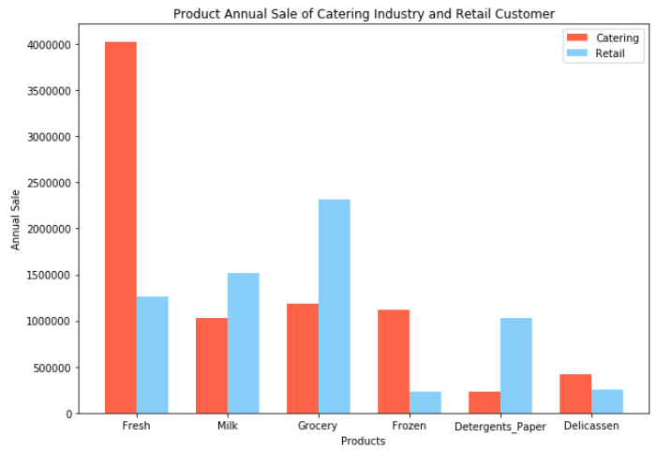
Channels
Catering high on Fresh, Frozen and Delicatessen
Retail high on Milk, Grocery, Detergents and Paper

Slide 9
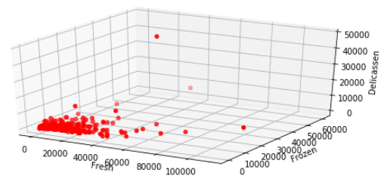
D_catering
Based on 3 product types
Fresh
Frozen
Delicatessen
Those 3 catering purchase more than retail

Slide 10
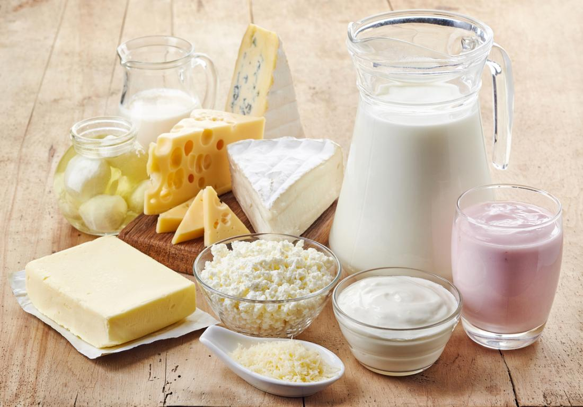
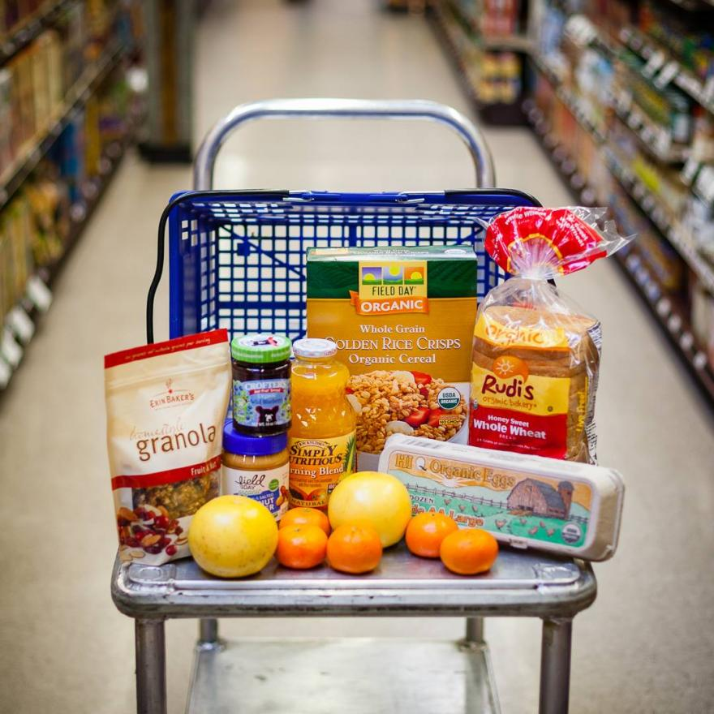
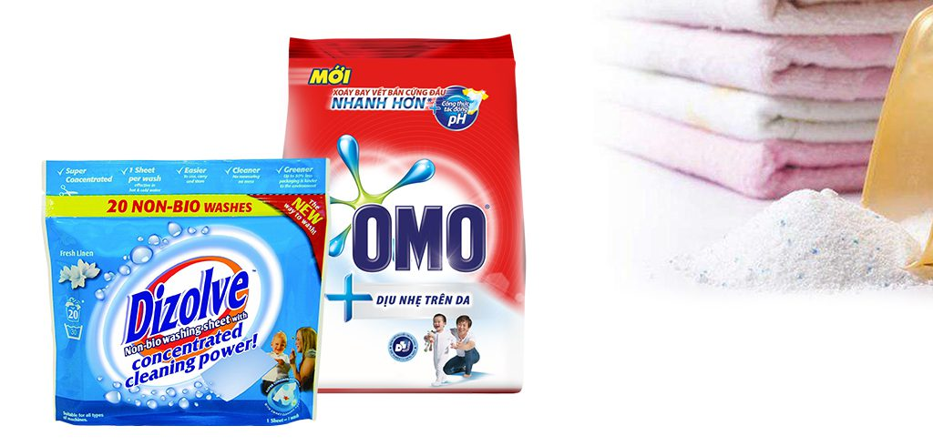

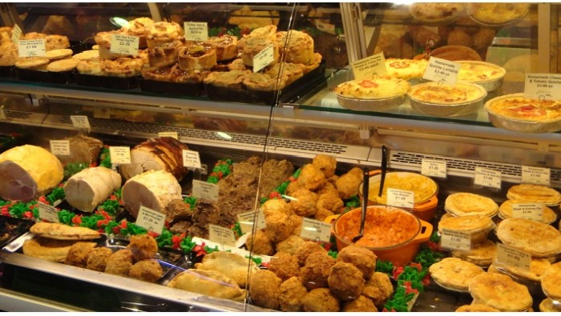
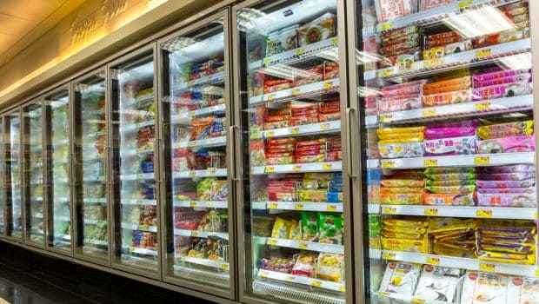
CLUSTER CUSTOMERS
CATERING INDUSTRY
298 CUSTOMERS
USE KMENAS
3 CLUSTERS
High on Fresh, Frozen and Delicassen PRODUCTS
RETAIL CUSTOMERS
142 CUSTOMERS
USE Hierarchical
3 CLUSTERS
High on Milk, Grocery, Detergents and Paper PRODUCTS

Slide 11
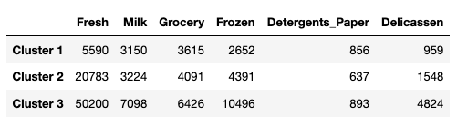

Cluster Catering
Cluster 1: Lower spender catering business
Cluster 2: Medium spender catering business
Cluster 3: High spender catering business
High spender spend a lot on Fresh and Frozen products
Medium and High combined to 114 customers

Slide 12
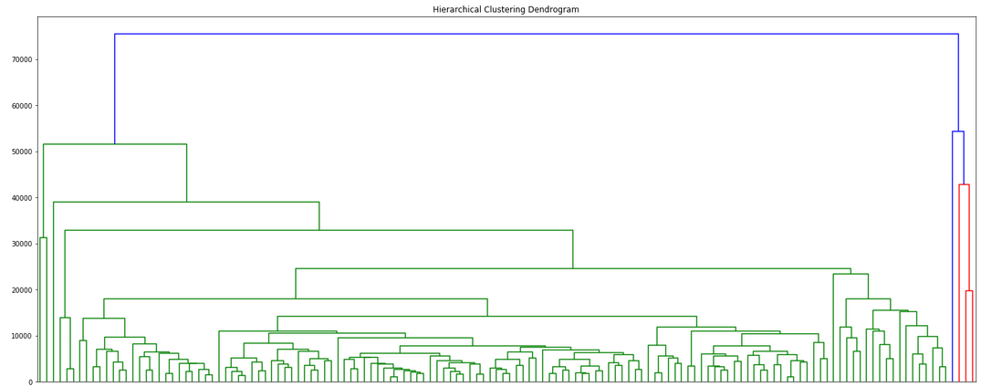
Cluster Retail
Cluster 1: Majority Cluster 2: Only 1 Cluster 3: Only 3

Slide 13


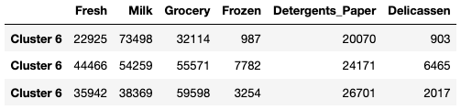
Cluster Retail

Slide 14
Recommendation
Put correlated products in near section / area
High Spenders in Catering purchase more on Fresh, So fresh need to be sufficient for them
High spenders in retail purchase more on Milk, grocery, detergents and paper, So those need to be placed near each other for customers’ convenience

Slide 15
Q & A

